Slide 1
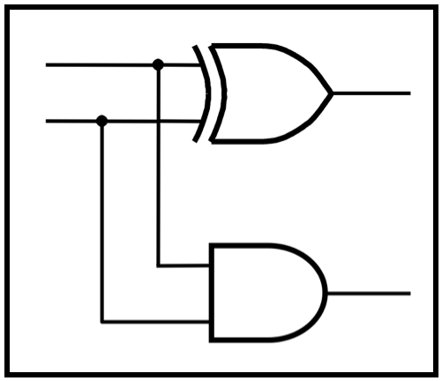
CprE 281:
Digital Logic
Instructor: Alexander Stoytchev
http://www.ece.iastate.edu/~alexs/classes/

Slide 2
D Flip-Flops
CprE 281: Digital Logic
Iowa State University, Ames, IA
Copyright © Alexander Stoytchev

Slide 3
Quick Review

Slide 4
A simple memory element with NOT Gates
x
x
x
[ Figure 5.2 from the textbook ]

Slide 5
A simple memory element with NAND Gates
x
x
x

Slide 6
A simple memory element with NOR Gates
x
x
x

Slide 7
Basic Latch

Slide 8
A simple memory element with NOR Gates

Slide 9
A simple memory element with NOR Gates

Slide 10
A simple memory element with NOR Gates
Set
Reset

Slide 11
A memory element with NOR gates
Reset
Set
Q
[ Figure 5.3 from the textbook ]

Slide 12
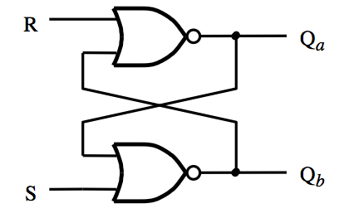
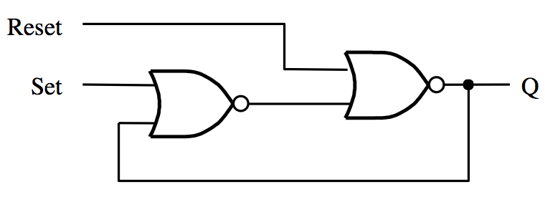
Two Different Ways to Draw the Same Circuit
[ Figure 5.3 & 5.4 from the textbook ]

Slide 13
Circuit and Characteristic Table for the Basic Latch
Note that Q_{a} and Q_{b} are
inverses of each other!
R
S
R
Q
a
Q
b
Q
a
0
0
0/1 1/0
(no change)
0
1
0
1
1
0
1
0
Q
b
1
1
0
0
S
(a) Circuit
(b) Characteristic table
[ Figure 5.4a,b from the textbook ]

Slide 14
Oscillations and Undesirable States
When S=1 and R=1 both outputs of the latch are equal to 0, i.e., Q_{a}=0 and Q_{b}=0.
Thus, the two outputs are no longer complements of each other.
This is undesirable as many of the circuits that we will build later with these latches rely on the assumption that the two outputs are always complements of each other.
(This is obviously not the case for the basic latch, but we will patch it later to eliminate this problem).

Slide 15
Oscillations and Undesirable States
An even bigger problem occurs when we transition from S=R=1 to S=R=0.
When S=R=1 we have Q_{a}=Q_{b}=0. After the transition to S=R=0, however, we get Q_{a}=Q_{b}=1, which would immediately cause Q_{a}=Q_{b}=0, and so on.
If the gate delays and the wire lengths are identical, then this oscillation will continue forever.
In practice, the oscillation dies down and the output settles into either Q_{a}=1 and Q_{b}=0 or Q_{a}=0 and Q_{b}=1.
The problem is that we can't predict which one of these two it will settle into.

Slide 16
Timing Diagram for the Basic Latch with NOR Gates
R
S
R
Q
a
Q
b
Q
a
0
0
0/1 1/0
(no change)
0
1
0
1
1
0
1
0
Q
b
1
1
0
0
S
(a) Circuit
(b) Characteristic table
t
1
t
2
t
3
t
4
t
5
t
6
t
7
t
8
t
9
t
10
1
R
0
1
S
0
1
Q
a
?
0
1
Q
b
?
0
Time
(c) Timing diagram
[ Figure 5.4 from the textbook ]

Slide 17
Timing Diagram for the Basic Latch with NOR Gates
R
S
R
Q
a
Q
b
Q
a
0
0
0/1 1/0
(no change)
0
1
0
1
1
0
1
0
Q
b
1
1
0
0
S
(a) Circuit
(b) Characteristic table
t
1
t
2
t
3
t
4
t
5
t
6
t
7
t
8
t
9
t
10
1
R
0
1
S
0
1
Q
a
?
0
1
Q
b
?
0
Time
(c) Timing diagram
[ Figure 5.4 from the textbook ]

Slide 18
Timing Diagram for the Basic Latch with NOR Gates
R
S
R
Q
a
Q
b
Q
a
0
0
0/1 1/0
(no change)
0
1
0
1
1
0
1
0
Q
b
1
1
0
0
S
(a) Circuit
(b) Characteristic table
t
1
t
2
t
3
t
4
t
5
t
6
t
7
t
8
t
9
t
10
1
R
0
1
S
0
1
Q
a
?
0
1
Q
b
?
0
Time
(c) Timing diagram

Slide 19
Timing Diagram for the Basic Latch with NOR Gates
R
S
R
Q
a
Q
b
Q
a
0
0
0/1 1/0
(no change)
0
1
0
1
1
0
1
0
Q
b
1
1
0
0
S
(a) Circuit
(b) Characteristic table
t
1
t
2
t
3
t
4
t
5
t
6
t
7
t
8
t
9
t
10
1
1
R
0
1
0
S
0
1
0
Q
a
?
0
1
1
Q
b
?
0
Time
(c) Timing diagram

Slide 20
Timing Diagram for the Basic Latch with NOR Gates
1
0
R
S
R
Q
a
Q
b
Q
a
0
0
0/1 1/0
(no change)
0
1
0
1
1
0
1
0
1
Q
b
1
1
0
0
S
0
(a) Circuit
(b) Characteristic table
t
1
t
2
t
3
t
4
t
5
t
6
t
7
t
8
t
9
t
10
1
1
R
0
1
0
S
0
1
0
Q
a
?
0
1
1
Q
b
?
0
Time
(c) Timing diagram

Slide 21
Timing Diagram for the Basic Latch with NOR Gates
0
0
R
S
R
Q
a
Q
b
Q
a
0
0
0/1 1/0
(no change)
0
1
0
1
1
0
1
0
1
Q
b
1
1
0
0
S
0
(a) Circuit
(b) Characteristic table
t
1
t
2
t
3
t
4
t
5
t
6
t
7
t
8
t
9
t
10
1
0
R
0
1
0
S
0
1
0
Q
a
?
0
1
1
Q
b
?
0
Time
(c) Timing diagram

Slide 22
Timing Diagram for the Basic Latch with NOR Gates
0
0
R
S
R
Q
a
Q
b
1
Q
a
0
0
0/1 1/0
(no change)
0
1
0
1
0
1
0
1
0
1
Q
b
1
1
0
0
S
0
(a) Circuit
(b) Characteristic table
t
1
t
2
t
3
t
4
t
5
t
6
t
7
t
8
t
9
t
10
1
0
R
0
1
0
S
0
1
0
Q
a
?
0
1
1
Q
b
?
0
Time
(c) Timing diagram

Slide 23
Timing Diagram for the Basic Latch with NOR Gates
0
0
R
S
R
Q
a
Q
b
Q
a
0
0
0/1 1/0
(no change)
0
1
0
1
1
0
1
0
1
Q
b
1
1
0
0
S
0
(a) Circuit
(b) Characteristic table
t
1
t
2
t
3
t
4
t
5
t
6
t
7
t
8
t
9
t
10
1
0
R
0
1
0
S
0
1
0
Q
a
?
0
1
1
Q
b
?
0
Time
(c) Timing diagram

Slide 24
Timing Diagram for the Basic Latch with NOR Gates
0
0
R
S
R
Q
a
Q
b
Q
a
0
0
0/1 1/0
(no change)
0
1
0
1
1
0
1
0
1
Q
b
1
1
0
0
S
1
(a) Circuit
(b) Characteristic table
t
1
t
2
t
3
t
4
t
5
t
6
t
7
t
8
t
9
t
10
1
0
R
0
1
1
S
0
1
0
Q
a
?
0
1
1
Q
b
?
0
Time
(c) Timing diagram

Slide 25
Timing Diagram for the Basic Latch with NOR Gates
0
0
R
S
R
Q
a
Q
b
1
Q
a
0
0
0/1 1/0
(no change)
0
1
0
1
0
1
0
1
0
1
Q
b
1
1
0
0
S
1
(a) Circuit
(b) Characteristic table
t
1
t
2
t
3
t
4
t
5
t
6
t
7
t
8
t
9
t
10
1
0
R
0
1
1
S
0
1
0
Q
a
?
0
1
1
Q
b
?
0
Time
(c) Timing diagram

Slide 26
Timing Diagram for the Basic Latch with NOR Gates
0
0
R
S
R
Q
a
Q
b
Q
a
0
0
0/1 1/0
(no change)
0
1
0
1
1
0
1
0
0
Q
b
1
1
0
0
S
1
(a) Circuit
(b) Characteristic table
t
1
t
2
t
3
t
4
t
5
t
6
t
7
t
8
t
9
t
10
1
0
R
0
For a brief moment the latch
goes through the undesirable
state Q_{a}=0 and Q_{b}=0.
1
1
S
0
1
0
Q
a
?
0
1
0
Q
b
?
0
Time
(c) Timing diagram

Slide 27
Timing Diagram for the Basic Latch with NOR Gates
0
0
R
S
R
Q
a
Q
b
0
Q
a
0
0
0/1 1/0
(no change)
0
1
0
1
0
1
0
1
0
0
Q
b
1
1
0
0
S
1
(a) Circuit
(b) Characteristic table
t
1
t
2
t
3
t
4
t
5
t
6
t
7
t
8
t
9
t
10
1
0
R
0
1
1
But these zeros loop around ...
S
0
1
0
Q
a
?
0
1
0
Q
b
?
0
Time
(c) Timing diagram

Slide 28
Timing Diagram for the Basic Latch with NOR Gates
0
1
R
S
R
Q
a
Q
b
Q
a
0
0
0/1 1/0
(no change)
0
1
0
1
1
0
1
0
0
Q
b
1
1
0
0
S
1
(a) Circuit
(b) Characteristic table
t
1
t
2
t
3
t
4
t
5
t
6
t
7
t
8
t
9
t
10
1
0
R
0
1
1
... and set it to Q_{a}=1 and Q_{b}=0.
S
0
1
1
Q
a
?
0
1
0
Q
b
?
0
Time
(c) Timing diagram

Slide 29
Timing Diagram for the Basic Latch with NOR Gates
0
1
R
S
R
Q
a
Q
b
0
Q
a
0
0
0/1 1/0
(no change)
0
1
0
1
1
1
0
1
0
0
Q
b
1
1
0
0
S
1
(a) Circuit
(b) Characteristic table
t
1
t
2
t
3
t
4
t
5
t
6
t
7
t
8
t
9
t
10
1
0
R
0
1
1
The new values also loop around ...
S
0
1
1
Q
a
?
0
1
0
Q
b
?
0
Time
(c) Timing diagram

Slide 30
Timing Diagram for the Basic Latch with NOR Gates
0
1
R
S
R
Q
a
Q
b
0
Q
a
0
0
0/1 1/0
(no change)
0
1
0
1
1
1
0
1
0
0
Q
b
1
1
0
0
S
1
(a) Circuit
(b) Characteristic table
t
1
t
2
t
3
t
4
t
5
t
6
t
7
t
8
t
9
t
10
1
0
R
0
1
1
... but they leave the outputs the same.
S
0
1
1
Q
a
?
0
1
0
Q
b
?
0
Time
(c) Timing diagram

Slide 32
Timing Diagram for the Basic Latch with NOR Gates
R
S
R
Q
a
Q
b
Q
a
0
0
0/1 1/0
(no change)
0
1
0
1
1
0
1
0
Q
b
1
1
0
0
S
(a) Circuit
(b) Characteristic table
t
1
t
2
t
3
t
4
t
5
t
6
t
7
t
8
t
9
t
10
1
R
0
1
S
0
1
Q
a
?
0
1
Q
b
?
0
Time
(c) Timing diagram
[ Figure 5.4 from the textbook ]

Slide 33
Timing Diagram for the Basic Latch with NOR Gates
R
S
R
Q
a
Q
b
Q
a
0
0
0/1 1/0
(no change)
0
1
0
1
1
0
1
0
Q
b
1
1
0
0
S
(a) Circuit
(b) Characteristic table
t
1
t
2
t
3
t
4
t
5
t
6
t
7
t
8
t
9
t
10
1
R
0
1
S
0
1
Q
a
?
0
1
Q
b
?
0
Time
(c) Timing diagram
[ Figure 5.4 from the textbook ]

Slide 34
Timing Diagram for the Basic Latch with NOR Gates
R
S
R
Q
a
Q
b
Q
a
0
0
0/1 1/0
(no change)
0
1
0
1
1
0
1
0
Q
b
1
1
0
0
S
(a) Circuit
(b) Characteristic table
t
1
t
2
t
3
t
4
t
5
t
6
t
7
t
8
t
9
t
10
1
R
0
1
S
0
1
Q
a
?
0
1
Q
b
?
0
Time
(c) Timing diagram
[ Figure 5.4 from the textbook ]

Slide 35
Timing Diagram for the Basic Latch with NOR Gates
R
S
R
Q
a
Q
b
Q
a
0
0
0/1 1/0
(no change)
0
1
0
1
1
0
1
0
Q
b
1
1
0
0
S
(a) Circuit
(b) Characteristic table
A transition from
S=R=1 to
S=R=0
causes oscillations
of the two output
values Qa and Qb.
t
1
t
2
t
3
t
4
t
5
t
6
t
7
t
8
t
9
t
10
1
R
0
1
S
0
1
Q
a
?
0
1
Q
b
?
0
Time
(c) Timing diagram
[ Figure 5.4 from the textbook ]

Slide 36
Basic Latch with NAND Gates

Slide 37
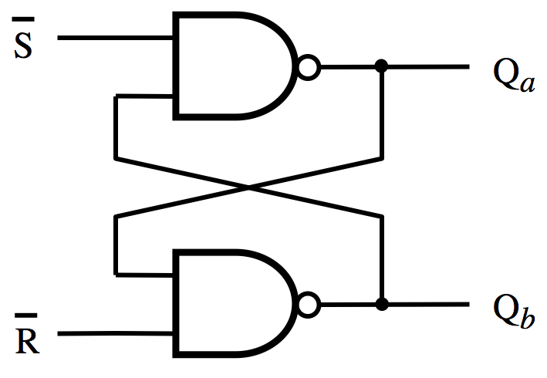
Circuit for the Basic Latch with NAND Gates

Slide 38
Basic Latch
(with NOR Gates)
Basic Latch
(with NAND Gates)
Notice that in the NAND case the two inputs are swapped and negated.
The labels of the outputs are the same in both cases.

Slide 39
Basic Latch
(with NOR Gates)
Basic Latch
(with NAND Gates)
SR Latch
SR Latch

Slide 40
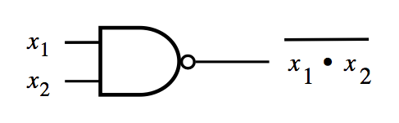
Circuit and Characteristic Table
S
Q
S
R
Q
a
Q
b
S
R
Q
a
Q
b
a
0
0
1
1
0
0
0/1 1/0
(no change)
0
1
1
0
0
1
0
1
1
0
0
1
1
0
1
0
Q
b
1
1
0/1 1/0
(no change)
1
1
1
1
R
(a) Circuit
(b) Characteristic table
(version 1)
(c) Characteristic table
(version 2)
NAND Gate Truth table
NAND Gate
x₁ | x₂ | f
0 | 0 | 1
0 | 1 | 1
1 | 0 | 1
1 | 1 | 0

Slide 41
Basic Latch
(with NOR Gates)
Basic Latch
(with NAND Gates)
S
R
Q
a
Q
b
S
R
Q
a
Q
b
0
0
0/1 1/0
(no change)
0
0
0/1 1/0
(no change)
0
1
0
1
0
1
0
1
1
0
1
0
1
0
1
0
1
1
0
0
1
1
1
1

Slide 42
Basic Latch
(with NOR Gates)
Basic Latch
(with NAND Gates)
S
R
Q
a
Q
b
S
R
Q
a
Q
b
0
0
0/1 1/0
(no change)
Latch
0
0
0/1 1/0
(no change)
Latch
0
1
0
1
Reset
0
1
0
1
Reset
1
0
1
0
Set
1
0
1
0
Set
1
1
0
0
Undesirable
1
1
1
1
Undesirable

Slide 43
Basic Latch
(with NOR Gates)
Basic Latch
(with NAND Gates)
S
R
Q
a
Q
b
S
R
Q
a
Q
b
0
0
0/1 1/0
(no change)
Latch
0
0
0/1 1/0
(no change)
Latch
0
1
0
1
Reset
0
1
0
1
Reset
1
0
1
0
Set
1
0
1
0
Set
1
1
0
0
Undesirable
1
1
1
1
Undesirable
The two characteristic tables are the same
(except for the last row, which is the undesirable configuration).

Slide 44
Oscillations and Undesirable States
The basic latch with NAND gates also suffers form oscillation problems, similar to the basic latch implemented with NOR gates.
Try to do this analysis on your own.

Slide 45
Gated SR Latch

Slide 46
Motivation
The basic latch changes its state when the input signals change
It is hard to control when these input signals will change and thus it is hard to know when the latch may change its state.
We want to have something like an Enable input.
In this case it is called the “Clock” input because it is desirable for the state changes to be synchronized.

Slide 47
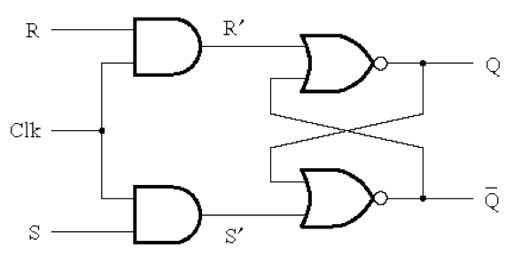
Circuit Diagram for the Gated SR Latch
[ Figure 5.5a from the textbook ]

Slide 48
Circuit Diagram for the Gated SR Latch
This is the “gate”
of the gated latch

Slide 49
Circuit Diagram for the Gated SR Latch
Notice that these are complements of each other

Slide 50
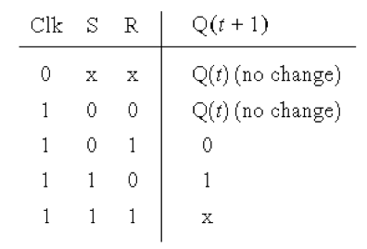
Circuit Diagram and Characteristic Table
for the Gated SR Latch
[ Figure 5.5a-b from the textbook ]

Slide 51
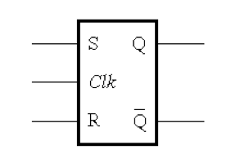
Circuit Diagram and Graphical Symbol
for the Gated SR Latch
[ Figure 5.5a,c from the textbook ]

Slide 52
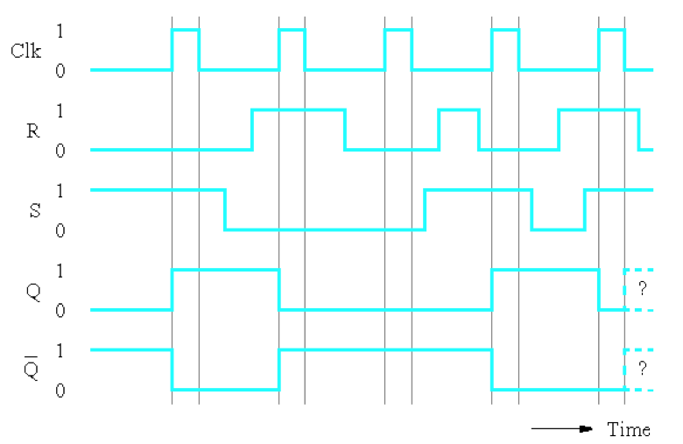
Timing Diagram for the Gated SR Latch
[ Figure 5.5c from the textbook ]

Slide 53
Gated SR latch with NAND gates
S
Q
Clk
Q
R
[ Figure 5.6 from the textbook ]

Slide 54
Gated SR latch with NAND gates
S
Q
Clk
Q
R
In this case the “gate” is constructed using NAND gates! Not AND gates.

Slide 55
Gated SR latch with NAND gates
S
Q
Clk
Q
R
Also, notice that the positions of S and R are now swapped.

Slide 56
Gated SR latch with NAND gates
S
S
1
Q
Clk = 1
1
Q
R
R
Finally, notice that when Clk=1 this turns into the
basic latch with NAND gates, i.e., the SR Latch.

Slide 57
Gated SR latch with NOR gates
Gated SR latch with NAND gates
S
Q
Clk
Q
R

Slide 58
Gated SR latch with NOR gates
Gated SR latch with NAND gates
S
Q
Clk
Q
R
Graphical symbols are the same

Slide 59
Gated SR latch with NOR gates
(undesirable)
Gated SR latch with NAND gates
S
Q
Clk
Q
(undesirable)
R
Characteristic tables are the same

Slide 60
Gated D Latch

Slide 61
Motivation
Dealing with two inputs (S and R) could be messy. For example, we may have to reset the latch before some operations in order to store a specific value but the reset may not be necessary depending on the current state of the latch.
Why not just have one input and call it D.
The D latch can be constructed using a simple modification of the SR latch.

Slide 62
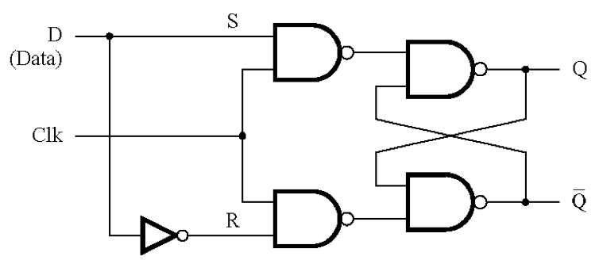
Circuit Diagram for the Gated D Latch
[ Figure 5.7a from the textbook ]

Slide 63
Circuit Diagram for the Gated D Latch
This is the only
new thing here.
[ Figure 5.7a from the textbook ]

Slide 64
Circuit Diagram for the Gated D Latch
0
0
0
[ Figure 5.7a from the textbook ]

Slide 65
Circuit Diagram for the Gated D Latch
1
0
0
0
1
S
R
Q
a
Q
b
0
0
1
1
0
1
1
0
1
0
0
1
1
1
0/1 1/0
(no change)
[ Figure 5.7a from the textbook ]

Slide 66
Circuit Diagram for the Gated D Latch
1
1
1
[ Figure 5.7a from the textbook ]

Slide 67
Circuit Diagram for the Gated D Latch
0
0
1
1
1
1
[ Figure 5.7a from the textbook ]

Slide 68
Circuit Diagram for the Gated D Latch
0
0
1
1
1
1
0
1
S
R
Q
a
Q
b
0
0
1
1
0
1
1
0
1
0
0
1
1
1
0/1 1/0
(no change)
[ Figure 5.7a from the textbook ]

Slide 69
Circuit Diagram for the Gated D Latch
0
0
1
0
1
1
1
0
1
1
S
R
Q
a
Q
b
0
0
1
1
0
1
1
0
1
0
0
1
1
1
0/1 1/0
(no change)
[ Figure 5.7a from the textbook ]

Slide 70
Circuit Diagram for the Gated D Latch
1
1
0
1
1
1
1
1
0
0
S
R
Q
a
Q
b
0
0
1
1
0
1
1
0
1
0
0
1
1
1
0/1 1/0
(no change)
[ Figure 5.7a from the textbook ]

Slide 71
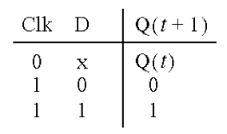
Circuit Diagram and Characteristic Table
for the Gated D Latch
Note that it is now impossible to have S=R=1.
[ Figure 5.7a,b from the textbook ]

Slide 72
Circuit Diagram and Characteristic Table
for the Gated D Latch
When Clk=1 the output follows the D input.
When Clk=0 the output cannot be changed.
[ Figure 5.7a,b from the textbook ]

Slide 73
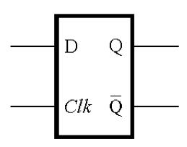
Circuit Diagram and Graphical Symbol
for the Gated D Latch
[ Figure 5.7a,c from the textbook ]

Slide 74
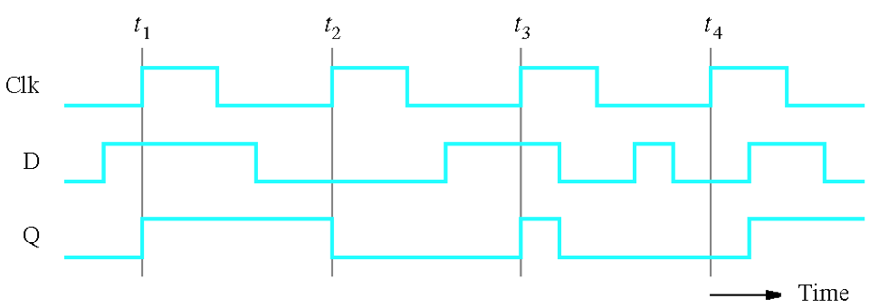
Timing Diagram for the Gated D Latch
[ Figure 5.7d from the textbook ]

Slide 75
Setup and hold times
t
su
t
h
Clk
D
Q
Setup time (t_{su}) – the minimum time that the D signal must be stable
prior to the the negative edge of the Clock signal.
Hold time (t_{h}) – the minimum time that the D signal must remain stable
after the the negative edge of the Clock signal.
[ Figure 5.8 from the textbook ]

Slide 76
Master-Slave D Flip-Flop

Slide 77
Constructing a Master-Slave D Flip-Flop
From Two D Latches
Master
Slave

Slide 78
Constructing a Master-Slave D Flip-Flop
From Two D Latches
Master
Slave

Slide 79
Constructing a Master-Slave D Flip-Flop
From Two D Latches
Master
Slave

Slide 80
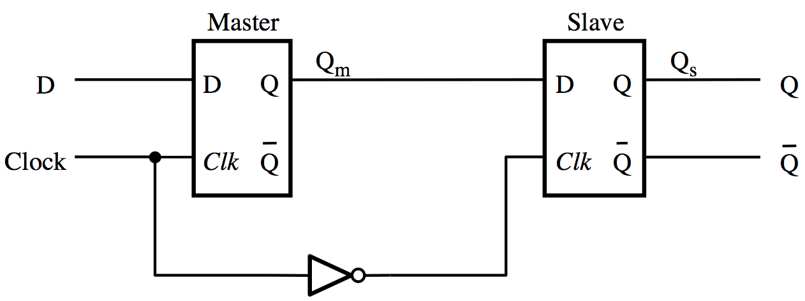
Constructing a Master-Slave D Flip-Flop
From Two D Latches
[ Figure 5.9a from the textbook ]

Slide 81
Constructing a Master-Slave D Flip-Flop
From one D Latch and one Gated SR Latch
(This version uses one less NOT gate)
Master
Slave

Slide 82
Constructing a Master-Slave D Flip-Flop
From one D Latch and one Gated SR Latch
(This version uses one less NOT gate)
Master
Slave

Slide 83
Edge-Triggered D Flip-Flops

Slide 84
Motivation
In some cases we need to use a memory storage device that can change its state no more than once during each clock cycle.

Slide 85
Master-Slave D Flip-Flop
Master
Slave
Q
m
Q
D
D
Q
D
Q
s
Q
Clock
Clk
Q
Clk
Q
Q
(a) Circuit
[ Figure 5.9a from the textbook ]

Slide 86
Timing Diagram for the Master-Slave D Flip-Flop
Master
Slave
Q
m
Q
D
D
Q
D
Q
s
Q
Clock
Clk
Q
Clk
Q
Q
Clock
D
Q
m
Q
=
Q
s
[ Figure 5.9a,b from the textbook ]

Slide 87
Graphical Symbol for the Master-Slave D Flip-Flop
D
Q
Q
[ Figure 5.9c from the textbook ]

Slide 88
Graphical Symbol for the Master-Slave D Flip-Flop
D
Q
Q
The > means that this is edge-triggered
The small circle means that is is the negative edge
[ Figure 5.9c from the textbook ]

Slide 89
Negative-Edge-Triggered Master-Slave D Flip-Flop
Master
Slave
Q
m
Q
D
D
Q
D
Q
s
Q
Clock
Clk
Q
Clk
Q
Q
Positive-Edge-Triggered Master-Slave D Flip-Flop
Master
Slave
Q
m
Q
D
D
Q
D
Q
s
Q
Clock
Clk
Q
Clk
Q
Q

Slide 90
Negative-Edge-Triggered Master-Slave D Flip-Flop
D
Q
Q
Positive-Edge-Triggered Master-Slave D Flip-Flop
D
Q
Q

Slide 91
Other Types of Edge-Triggered
D Flip-Flops

Slide 92
D
D
Q
Q
Comparison of level-sensitive and edge-triggered D storage elements
a
Clock
Clk
Q
Q
a
D
Q
Q
b
Q
Q
b
D
Q
Q
c
Q
Q
c
Clock
D
Q
a
Q
b
Q
c

Slide 93
D
D
Q
Q
Comparison of level-sensitive and edge-triggered D storage elements
a
Clock
Clk
Q
Q
a
D
Q
Q
b
Q
Q
Level-sensitive
(the output mirrors the D input when Clk=1)
b
D
Q
Q
c
Q
Q
c
Clock
D
Q
a
Q
b
Q
c

Slide 94
D
D
Q
Q
Comparison of level-sensitive and edge-triggered D storage elements
a
Clock
Clk
Q
Q
a
D
Q
Q
b
Q
Q
Positive-edge-triggered
b
D
Q
Q
c
Q
Q
c
Clock
D
Q
a
Q
b
Q
c

Slide 95
D
D
Q
Q
Comparison of level-sensitive and edge-triggered D storage elements
a
Clock
Clk
Q
Q
a
D
Q
Q
b
Q
Q
Negative-edge-triggered
b
D
Q
Q
c
Q
Q
c
Clock
D
Q
a
Q
b
Q
c

Slide 96
A positive-edge-triggered D flip-flop
1
P3
2
P1
5
Q
Clock
P2
6
Q
3
D
Q
4
P4
Clock
Q
D
(a) Circuit
(b) Graphical symbol
[ Figure 5.11 from the textbook ]

Slide 97
A positive-edge-triggered D flip-flop
This circuit behaves like a positive-edge-triggered
D flip-flop, but it uses only 6 NAND gates.
Thus, it can be implemented with fewer transistors
than the master-slave D flip-flop.
1
P3
2
P1
5
Q
Clock
P2
6
Q
3
D
Q
4
P4
Clock
Q
D
(a) Circuit
(b) Graphical symbol
[ Figure 5.11 from the textbook ]

Slide 98
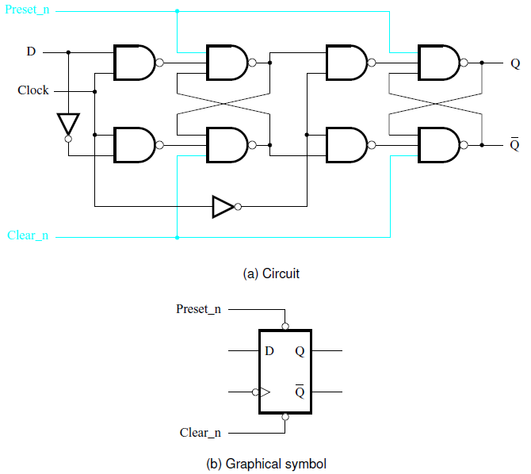
Master-slave D flip-flop with Clear and Preset
[ Figure 5.12 from the textbook ]

Slide 99
Positive-edge-triggered D flip-flop with Clear and Preset

Slide 100
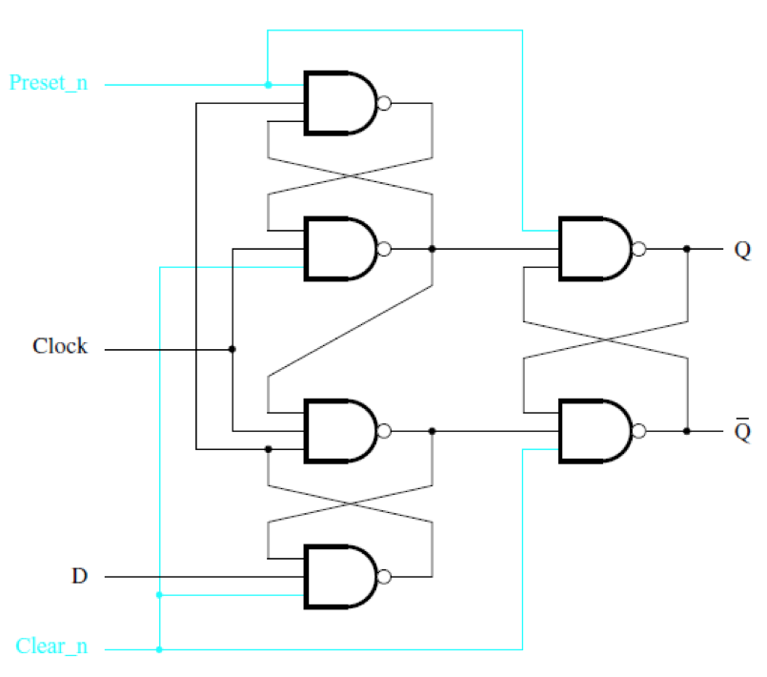
Positive-edge-triggered D flip-flop
with Clear and Preset
[ Figure 5.13a from the textbook ]

Slide 101
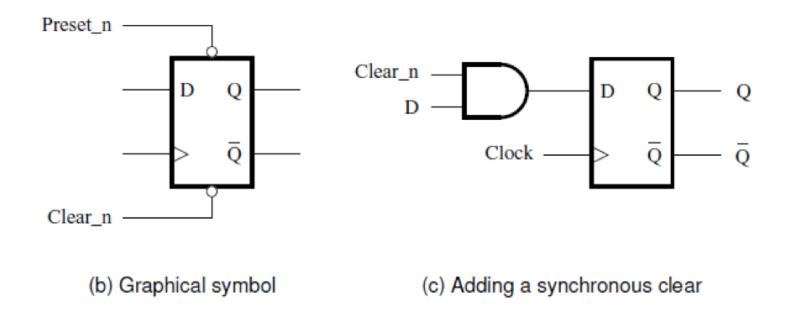
Positive-edge-triggered D flip-flop
with Clear and Preset
[ Figure 5.13b,c from the textbook ]

Slide 102
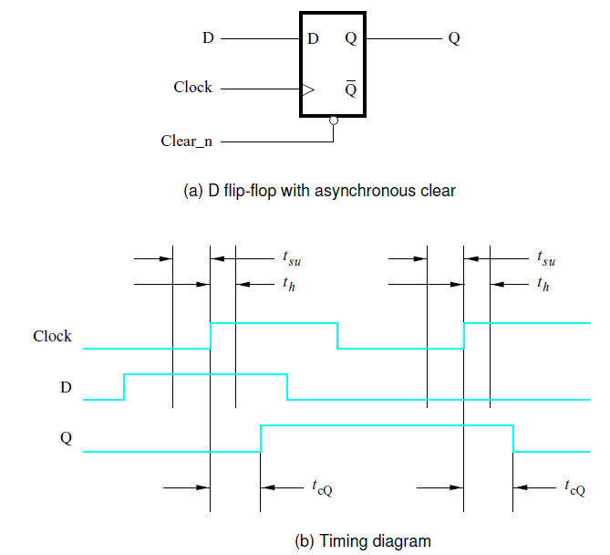
Flip-Flop Timing Parameters
Setup time
Hold time
clock-to-Q
propagation delay
[ Figure 5.14 from the textbook ]

Slide 103
Terminology
Basic Latch – is a feedback connection of two NOR gates or two NAND gates, which can store one bit of information. It can be set using the S input and reset to 0 using the R input.
Gated Latch – is a basic latch that includes input gating and a control input signal. The latch retains its existing state when the control input is equal to 0. Its state may be changed when the control signal is equal to 1.
[ Section 5.7 in the textbook ]

Slide 104
Terminology
Two types of gated latches
(the control input is the clock):
Gated SR Latch – uses the S and R inputs to set the latch to 1 or reset it to 0.
Gated D Latch – uses the D input to force the latch into a state that has the same logic value as the D input.
[ Section 5.7 in the textbook ]

Slide 105
Terminology
Flip-Flop – is a storage element that can have its output state changed only on the edge of the controlling clock signal.
Positive-edge triggered – if the state changes when the clock signal goes from 0 to 1.
Negative-edge triggered – if the state changes when the clock signal goes from 1 to 0.
[ Section 5.7 in the textbook ]

Slide 106
Terminology
The word latch is mainly used for storage elements, while clocked devices are described as flip-flops.
A latch is level-sensitive, whereas a flip-flop is edge-sensitive. That is, when a latch is enabled it becomes transparent, while a flip flop's output only changes on a single type (positive going or negative going) of clock edge.
[http://en.wikipedia.org/wiki/Flip-flop_(electronics)]

Slide 107
Questions?

Slide 108
THE END

